Slide 1
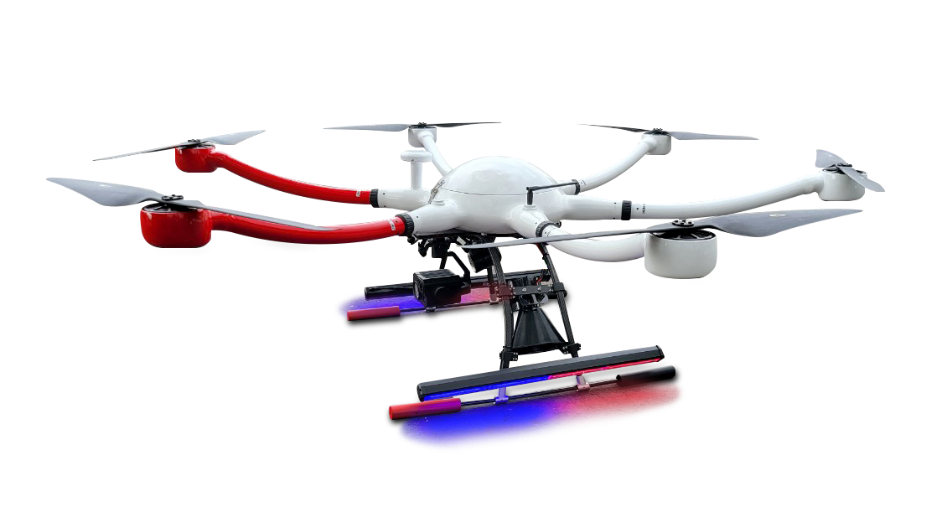
Perimeter Security Drone
“There was a 911 call claiming an active shooter was on campus. The call ended up being a hoax. As the first responder, it would have been great to send a drone to get a view of the area [and situation] before we arrived on scene.”
- Security Officer, Univ. of Nevada, Reno
Specifications:
Drone can be dispatched within 60 seconds
Extended search/monitor:100-minute flight time
Off site Ground Control Center (GCS) enables remote search/monitor operations
Live streaming to onsite public safety officers
Precision, Thermal and Night Vision cameras on board for complete site evaluation
On-board speaker is capable of broadcasting remote warnings and information
Optional capability of subduing the suspect
search light
speaker
Camera & sensor
www.hydaas.com
3141 Data Dr.
Rancho Cordova, CA

